Slide 1
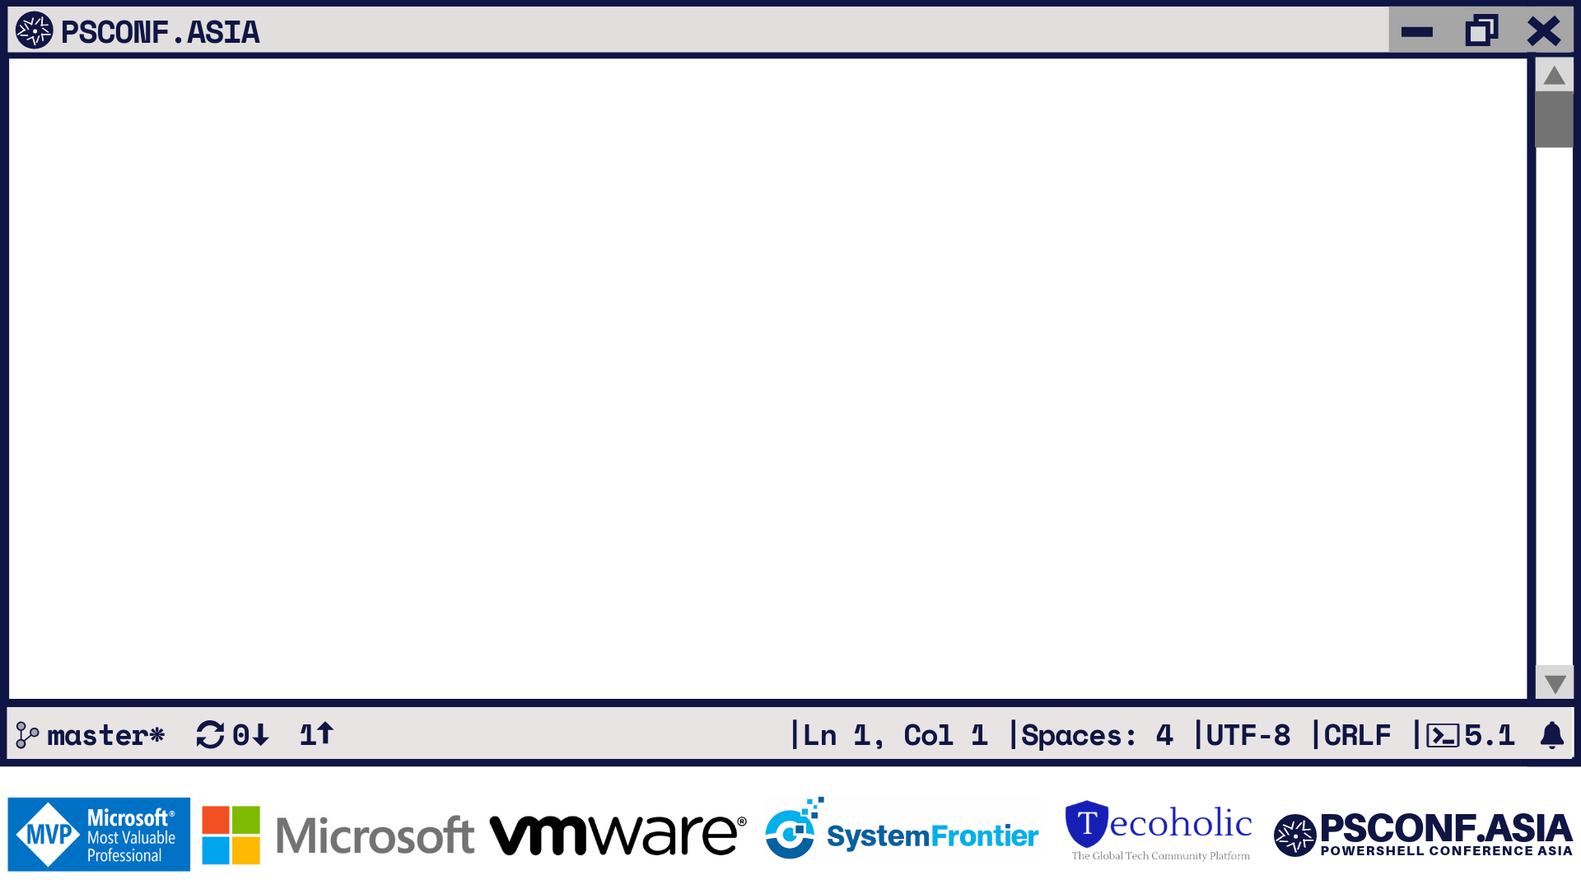
How PowerCLI Makes vSphere Configuration Management Easy
Luc Dekens
Kyle Ruddy

Slide 2
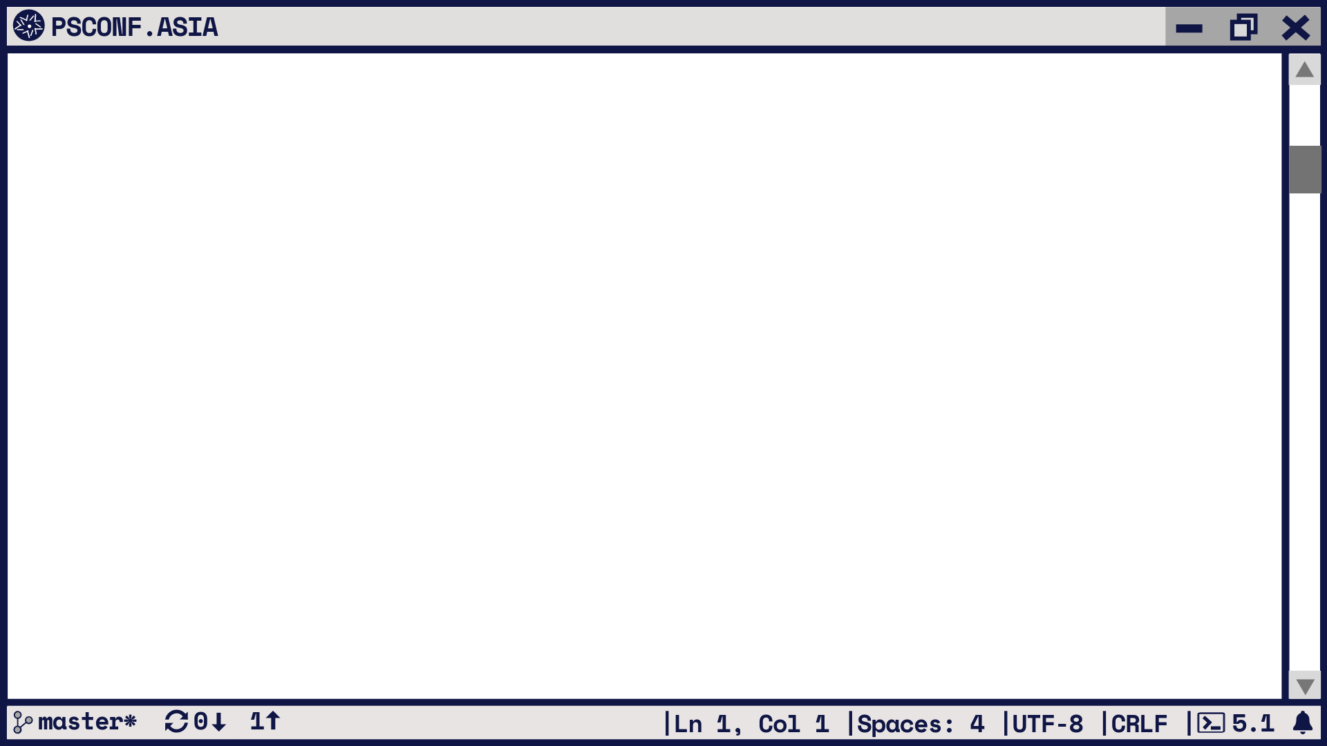
Luc Dekens
PowerCLI Mastermind
Writer
GitHub
Twitter
MS MVP
@ lucd.info
@ github.com/lucdekens
@lucd22
Cloud\Datacenter Management

Slide 3
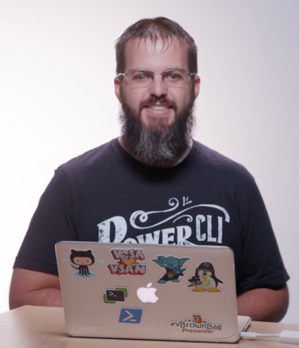
Kyle Ruddy
Senior Architect, Technical Marketing
Writer
GitHub
Podcast
Twitter
MS MVP
@ kmruddy.com
@ github.com/kmruddy
@ vBrownBag.com
@kmruddy
Cloud\Datacenter Management

Slide 4
Agenda
What is Configuration Management?
What is PowerShell?
What is PowerCLI?
Desired State Configuration (DSC) Introduction
DSC Resources for VMware
DSC Resource Testing

Slide 5
Configuration Management

Slide 6
“Configuration management (CM) is a systems engineering process for establishing and maintaining consistency of a product's performance, functional, and physical attributes with its requirements, design, and operational information throughout its life.”
https://en.wikipedia.org/wiki/Configuration_management

Slide 7
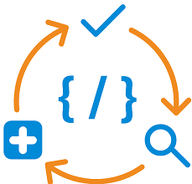
Provides:
Declarative and idempotent (repeatable) deployment
Unified configuration
Conformance
Configuration files separate intent:
Formerly: How I want to do it
Now: What I want it to be
Image Courtesy of: https://www.chef.io/configuration-management/

Slide 8






Configuration Management Breakdown
What’s really going on…
Repository
Configuration
Central Server / Point of Control
Node

Slide 9
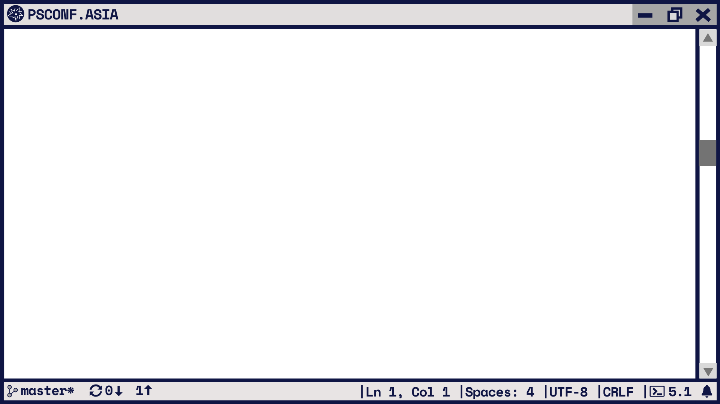
 | Ansible | Chef | Puppet | SaltStack | PowerShell DSC
Script Language | Python | Ruby | Custom Ruby DSL | Python | PowerShell
Infrastructure | Controller applies config via SSH | Chef Workstation push config to Chef Server, then to nodes | Puppet Master syncs config to nodes | Salt Master push config to Minion | Node pulls config from Pull Server
Central Point of Control | Ansible Tower | Chef Server | Puppet Master | Salt Master | Pull Server or Azure Automation
Script Terminology | Playbook / Roles | Recipes / Cookbooks | Manifests / Modules | State / Formula | Configurations / Resources
Task Execution Order | Sequential | Sequential | Non-Sequential | Sequential | Sequential
Partial Source: https://www.digitalocean.com/community/tutorials/an-introduction-to-configuration-management

Slide 10
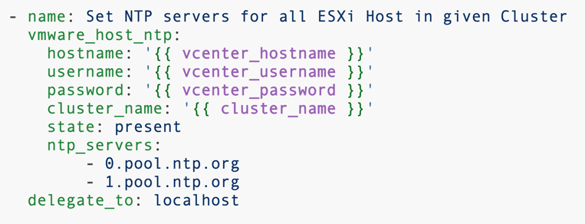
Ansible Example – VMware
Configure Host NTP Settings

Slide 11
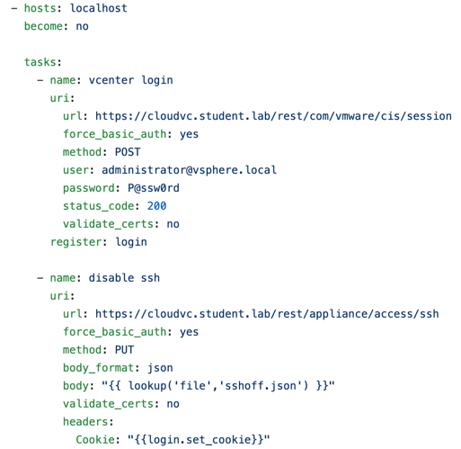
Ansible Example - URI
VCSA SSH Service Management

Slide 12
What is PowerShell?

Slide 13
A simple and straight-forward path to automation
Already installed on all modern Windows Operating Systems
Integrated and rich help system
Modular and Object-oriented
The best of a programming language melded with a scripting language
True portability of code via modules (and snap-ins)
PowerShell Core 6.0 available additionally for Linux and MacOS
Open Sourced: https://github.com/PowerShell/PowerShell

Slide 14
What is PowerCLI?

Slide 15
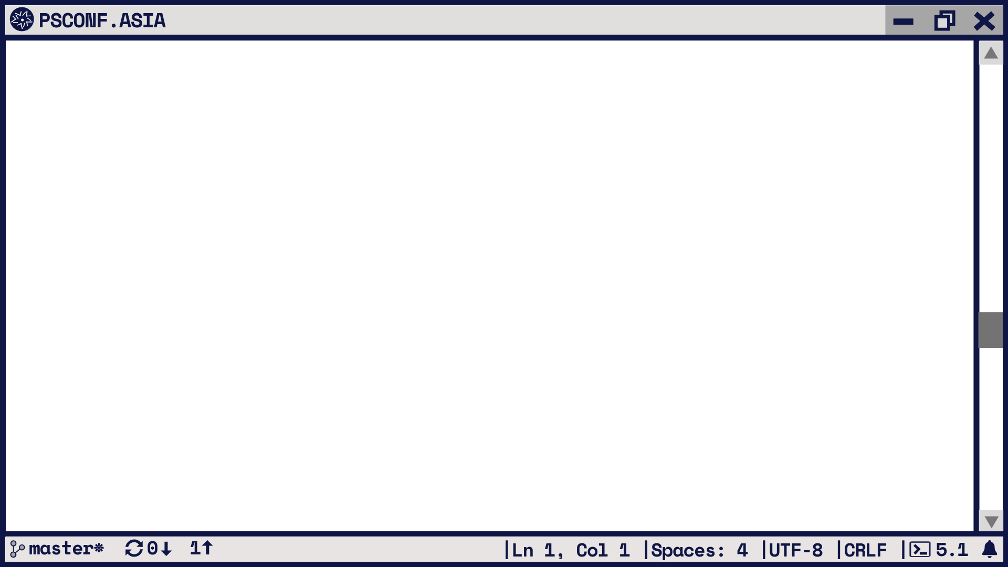
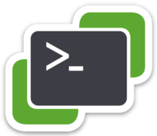
What is PowerCLI?
vCenter
vROps
VSAN
Update Manager
SRM
NSX-T
VMware Cloud on AWS
vCD
Horizon View
Image Builder
AutoDeploy
ESXi
HCX
PowerCLI
VMware’s command-line and scripting tool built on Windows PowerShell
Features more than 700 cmdlets for managing and automating vSphere, vCloud, and Horizon environments
One of the most robust and complete PowerShell deployments in the world

Slide 16
PowerShell Desired State Configuration

Slide 17
How DSC works
NODE 1
LCM
Node 1 MOF
User
User
config
NODE 2
LCM
Node 2 MOF

Slide 18
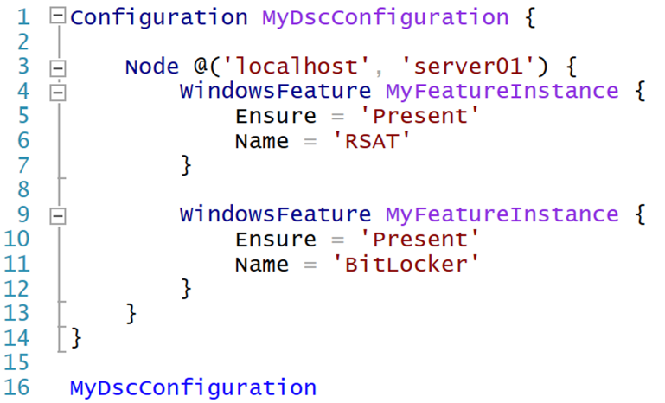

Slide 19
DSC Resources for VMware

Slide 20
DSC Resources for VMware
Introduced December of 2018: VMware.vSphereDSC
Allows declarative language-based management against vCenter and ESXi Hosts
Open Sourced: https://github.com/vmware/dscr-for-vmware
Contributions Welcome!
Dependencies:
PowerShell 5.1
PowerCLI 10.1.1 or newer
Requirements:
Able to run PowerShell as Administrator
PowerCLI and vSphere DSC installed for all users’ access

Slide 21

How the DSC Resources for VMware works
vCenter Server(s)
Configuration
File
LCM Proxy
Windows OS
PowerShell 5.1
PowerCLI 10.1.1+
ESXi Server(s)

Slide 22
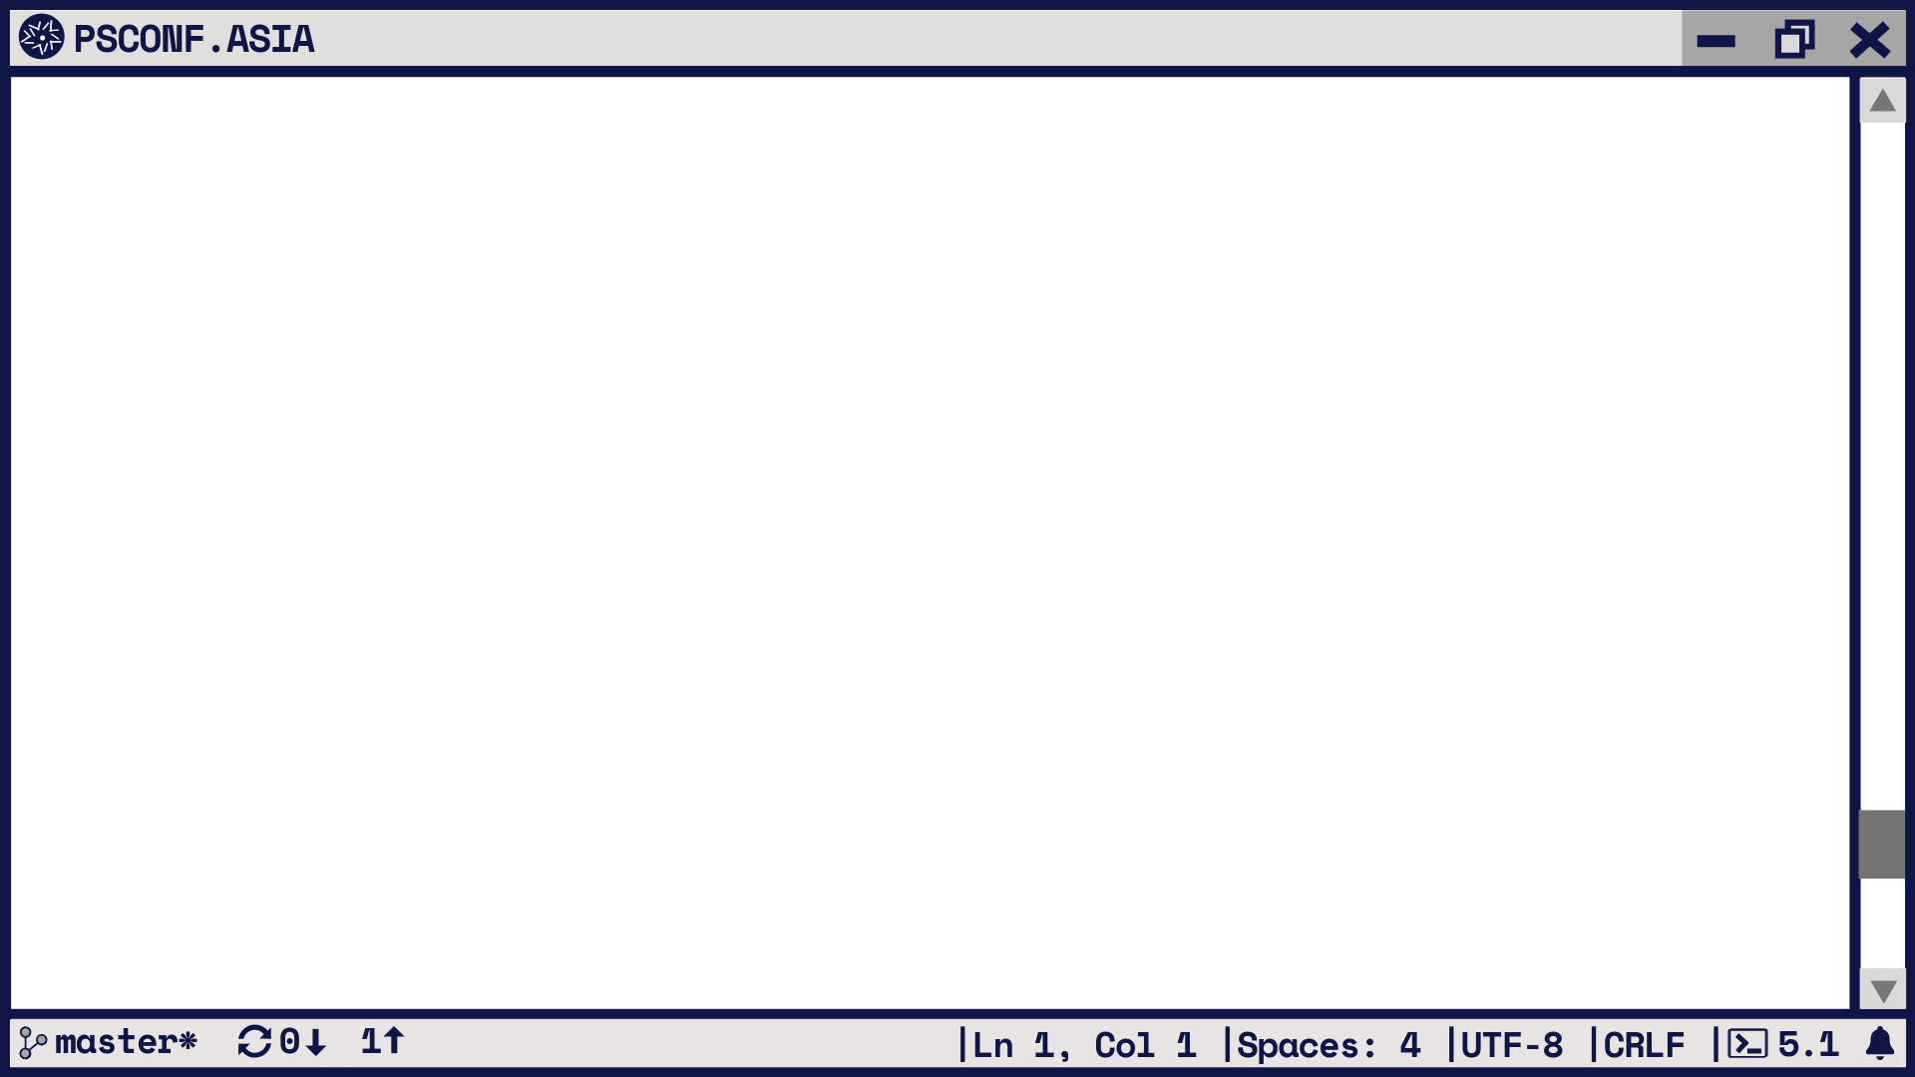
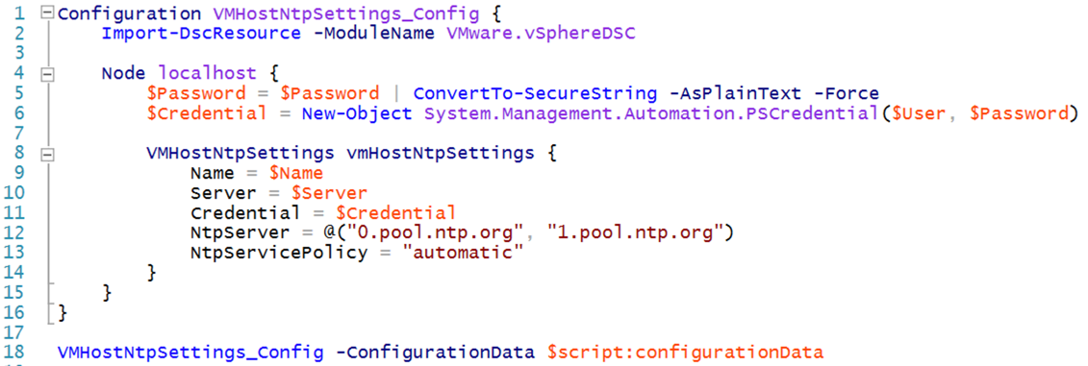

Slide 23
Currently Available

Slide 24
Work In Progress
Standard Switch Resources
Security
Shaping
Teaming
Cluster Resources
HA Settings
DRS Settings
VMHost Resources
Advanced Settings
PCI Passthrough
Power Policies

Slide 25
Demo Time!

Slide 26
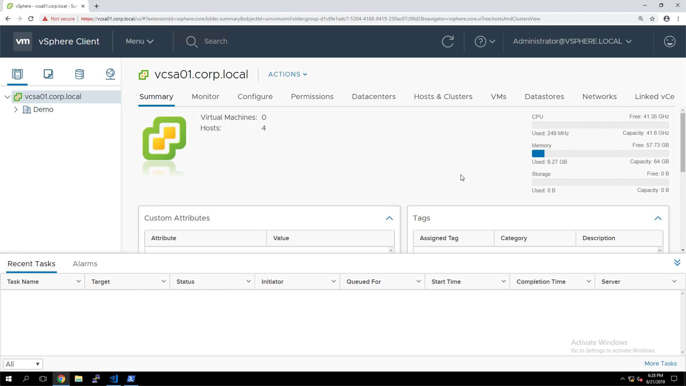

Slide 27
What About Integrations?

Slide 28
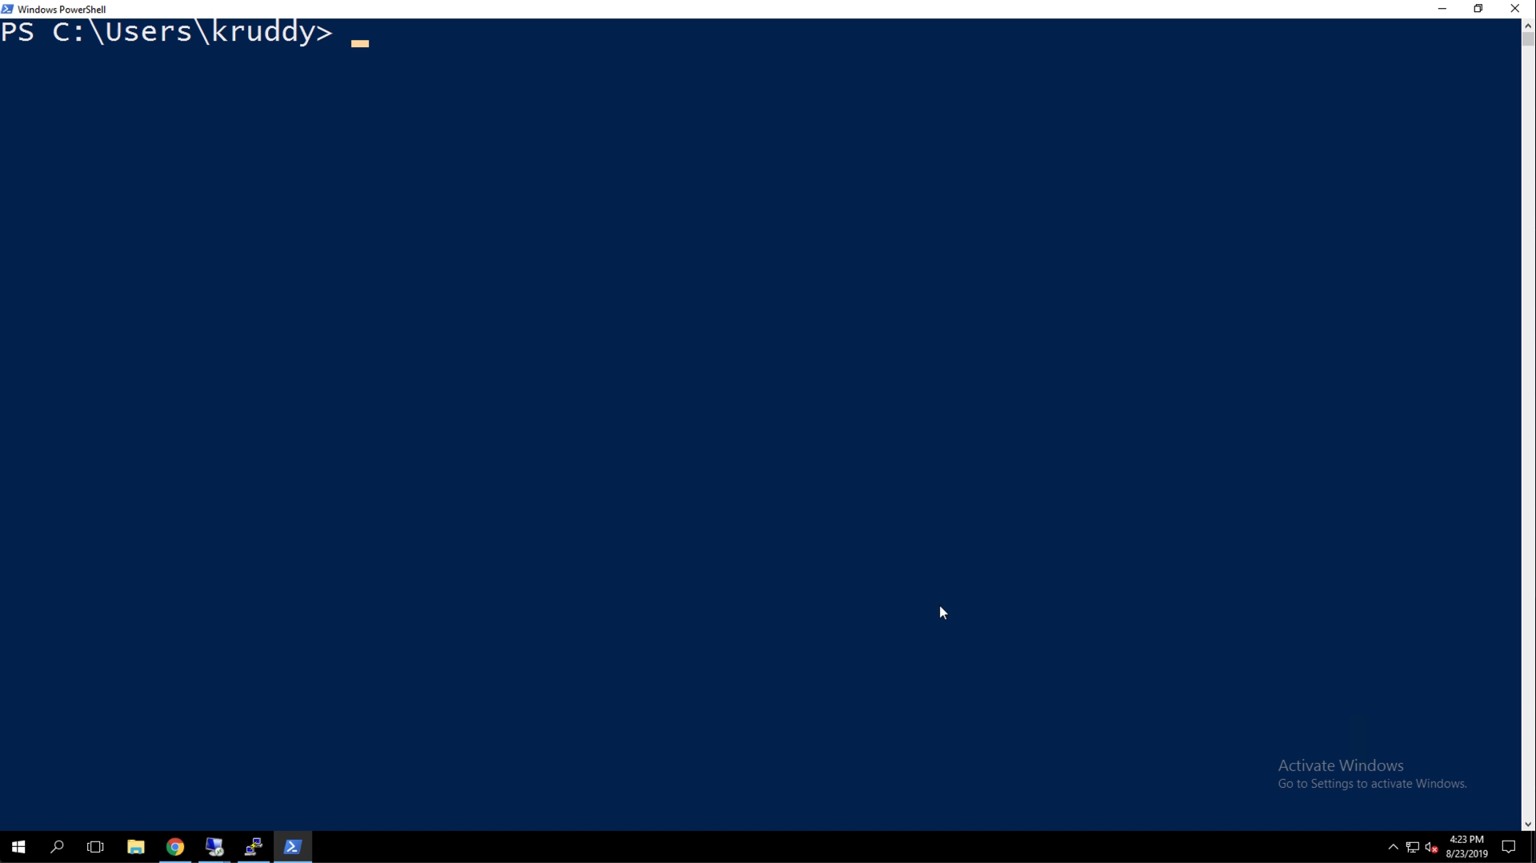

Slide 29
DSC Resource Testing

Slide 30
DSC and Pester
Why?
To validate new code is working
Unit Test
To validate it is behaving with other code
Integration Test
How?
Pester
PS Standard
Intuitive (somewhat)

Slide 31
Unit Testing
Piece of code
One DSC resource
One DSC resource function
Helpers
Mocking
Feed with all possibilities
Verify result
Expected vs Reality

Slide 32
Integration Testing
How does it behave with others?
One DSC resource
Composite DSC resource
Verify combinations
Expected vs Reality
Environment
Set up
Part of pipeline
Cattle!

Slide 33
Unit Testing – How It Is Done
DSC Resource Code
Mock
Types
Cmdlets
Pester
Test
Objects
Set
Get
No vSphere environment required!

Slide 34
Integration Testing – How It Is Done
DSC Resource Code
vSphere
Pester
Configurations
Configurations
Configurations
Configurations
Configurations
vSphere environment required!

Slide 35
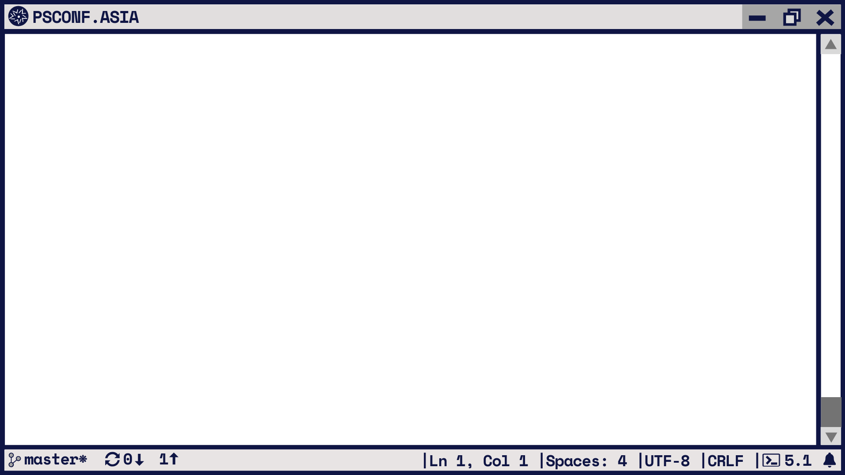
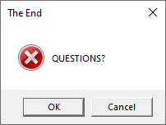

Slide 36
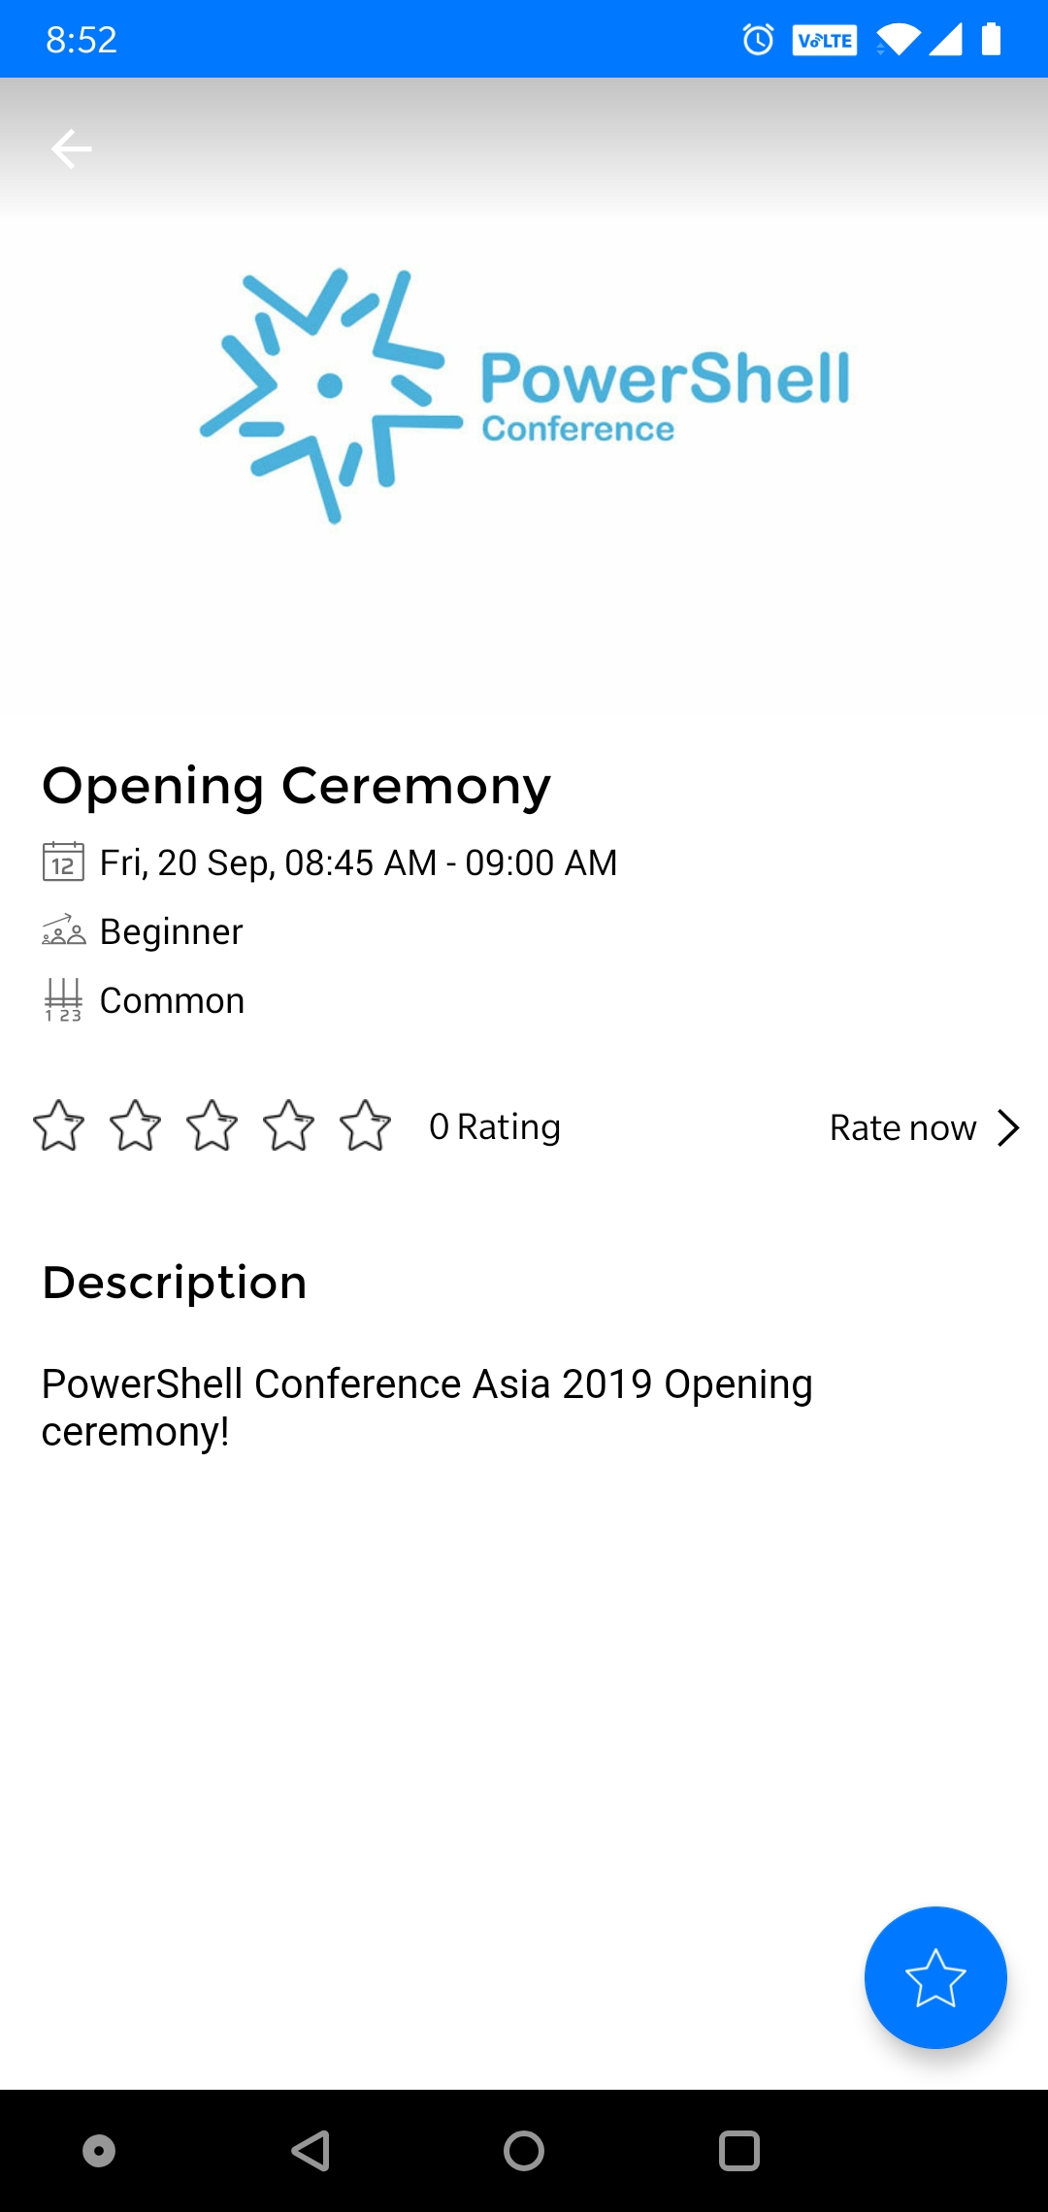
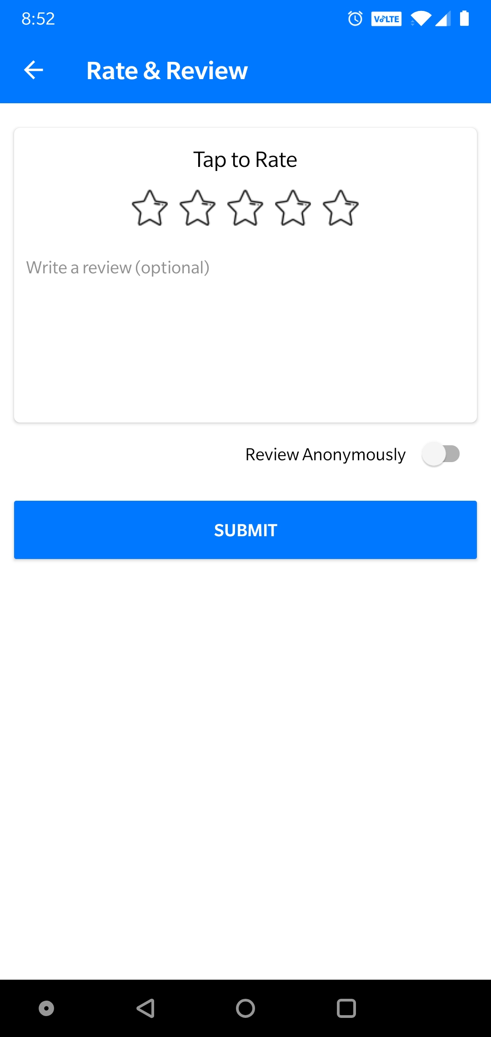

DO NOT Forget to rate the sessions!
https://my.eventraft.com/psconfasia19

Slide 37

Mock Types
Generated CS file
namespace VMware.Vim
{
namespace VMware.VimAutomation.ViCore.Types.V1
{
public interface VIContainer : InventoryItem
{
}

Slide 38
Mock VMware.VimAutomation.Core
Add-Type -Path "$($env:PSModulePath)/VMware.VimAutomation.Core/PowerCLITypes.cs"
function New-Folder {
[CmdletBinding(DefaultParameterSetName = "__AllParameterSets")]
param(
[Parameter(Mandatory = $true, ParameterSetName = "__AllParameterSets", ValueFromPipeline = $false)]
[string]
$Name,
[Parameter(Mandatory = $false, ParameterSetName = "__AllParameterSets", ValueFromPipeline = $true)]
[VMware.VimAutomation.ViCore.Types.V1.Inventory.VIContainer]
$Location,

Slide 39

Mock Objects
$script:datacenterHostFolder = [VMware.VimAutomation.ViCore.Impl.V1.Inventory.FolderImpl] @{
Id = $script:constants.DatacenterHostFolderId
Name = $script:constants.DatacenterHostFolderName
Parent = [VMware.VimAutomation.ViCore.Impl.V1.Inventory.DatacenterImpl] @{
Name = $script:constants.DatacenterName
}
}

Slide 40
Actual Unit tests 1
using module VMware.vSphereDSC
$script:moduleName = 'VMware.vSphereDSC'
InModuleScope -ModuleName $script:moduleName {
try {
$unitTestsFolder = Join-Path (Join-Path (Get-Module VMware.vSphereDSC -ListAvailable).ModuleBase 'Tests') 'Unit'
$modulePath = $env:PSModulePath
$resourceName = 'Folder'
. "$unitTestsFolder\TestHelpers\TestUtils.ps1"
# Calls the function to Import the mocked VMware.VimAutomation.Core module before all tests.
Invoke-TestSetup
. "$unitTestsFolder\TestHelpers\Mocks\MockData.ps1"
. "$unitTestsFolder\TestHelpers\Mocks\FolderMocks.ps1"

Slide 41
Actual Unit tests 2
Describe 'Folder\Test' -Tag 'Test’ {
BeforeAll {
# Arrange
New-MocksForFolder
}
Context 'Invoking with Ensure Present and non existing Folder’ {
BeforeAll {
# Arrange
$resourceProperties = New-MocksWhenEnsurePresentAndNonExistingFolder
$resource = New-Object -TypeName $resourceName -Property $resourceProperties
}
It 'Should return $false when the Folder does not exist’ {
# Act
$result = $resource.Test()
# Assert
$result | Should -Be $false
}
}

Slide 42

Configurations
Configuration Folder_WhenAddingFolderWithEmptyLocation_Config {
Import-DscResource -ModuleName VMware.vSphereDSC
Node $AllNodes.NodeName {
Datacenter $script:datacenterWithEmptyLocationResourceName {
Server = $Server
Credential = $script:viServerCredential
Name = $script:datacenterName
Location = $script:datacenterEmptyLocation
Ensure = 'Present'
}
Folder $script:folderWithEmptyLocationResourceName {
Server = $Server
Credential = $script:viServerCredential
Name = $script:folderName
Location = $script:folderWithEmptyLocation
DatacenterName = $script:datacenterName
DatacenterLocation = $script:datacenterEmptyLocation
Ensure = 'Present'
FolderType = $script:folderType
DependsOn = $script:datacenterWithEmptyLocationResourceId
}
}
}

Slide 43
Integration 1
$script:dscResourceName = 'Folder'
$script:moduleFolderPath = (Get-Module VMware.vSphereDSC -ListAvailable).ModuleBase
$script:integrationTestsFolderPath = Join-Path (Join-Path $moduleFolderPath 'Tests') 'Integration'
$script:configurationFile = `
"$script:integrationTestsFolderPath\Configurations\$($script:dscResourceName)\$($script:dscResourceName)_Config.ps1"
$script:configWhenAddingFolderWithEmptyLocation = "$($script:dscResourceName)_WhenAddingFolderWithEmptyLocation_Config"

Slide 44
Integration 2
Describe "$($script:dscResourceName)_Integration" {
Context "When using configuration $($script:configWhenAddingFolderWithEmptyLocation)" {
BeforeAll {
# Arrange
$startDscConfigurationParameters = @{
Path = $script:mofFileWhenAddingFolderWithEmptyLocationPath
#
}
# Act
Start-DscConfiguration @startDscConfigurationParameters
}
It 'Should compile and apply the MOF without throwing' {
# Arrange
$startDscConfigurationParameters = @{
Path = $script:mofFileWhenAddingFolderWithEmptyLocationPath
ComputerName = 'localhost’
#
}
# Act && Assert
{ Start-DscConfiguration @startDscConfigurationParameters } | Should -Not -Throw
}
}
}

